Slide 1
CODES OF ETHICS DAY 2019
OPEN UNIVERSITY, LONDON OFFICE
MAY 14TH 2019

Slide 2
ORGANIZERS’ INTRODUCTION
About this project
Lessons from last year
Today

Slide 3
1. ABOUT THIS PROJECT
Codes of Ethics Project
  Pooling of different perspectives, from inside and outside academia
  Aim: to understand and enhance codes of ethics
  3 x workshops + online toolkit
  Codes of Ethics Day 2018: codes for whole roles
  Codes of Ethics Day 2019: codes for specific behaviours
  Codes of Ethics Day 2020: [??institutional contexts??]

Slide 4
2. LESSONS FROM LAST YEAR
We each took away different things
No need to reinvent the wheel (but good to avoid replicating common errors)
Be aware of the limits of codes (they don’t work in isolation; they can give false sense of security; they can be wallpaper)
Three Four different but interdependent aspects of codes of conduct to think about:
  Function What is the code for?
  Content What should go in it and how should it be packaged?
  Use How will it be embedded? Enforced or inspirational?
  -----------------------------------------------------------------------------------------
  Process Who will produce and maintain the code? How? Who will they consult?

Slide 5
3. TODAY
Codes for specific behaviours:
  Whistleblowing and confidentiality Session A
  Bullying and harassment Session B + C
Process
  Online toolkit Session C
Learning method:
  Share perspectives and take away what you find useful
  Presentations + hands-on scrutiny
  Making connections (e.g. email sharing sheet)

Slide 6
SESSION A:
Confidentiality and whistleblowing

Slide 7
Some preliminary thoughts about confidentiality and whistleblowing
Whistleblowing versus confidentiality?
Two separate topics:
  Individual: the rights and wrongs of whistleblowing
  Institutional: effective whistleblowing policies
Whistleblowing vs self-righteous troublemaking?
NDAs

Slide 8
SESSION A: PRACTICAL
Using the contents page, agree on two or three code samples per table.
Read them and discuss the questions they raise (e.g. under ‘To consider’)
Feed back to the group in the following form:
“A good code on whistleblowing/confidentiality should…”

Slide 9
SESSION B:
Bullying and harassment

Slide 10
A preliminary thought about bullying and harassment
Bullying
Harassment
[protected characteristics]
Why the difference?
Answer: wider social justice and inclusivity?
If so, this is not reflected in the content of the codes. Should it be?

Slide 11
SESSION B: PRACTICAL
Using the contents page, agree on two or three code samples per table.
Read them and discuss the questions they raise (e.g. under ‘To consider’)
Feed back to the group in the following form:
“A good code on bullying/harassment should…”

Slide 12
SESSION C
Bullying and harassment (continued)
Online codes of ethics toolkit
Final thoughts + feedback

Slide 13
A Codes of Ethics Toolkit

Slide 14
WHAT AND WHY?
For:
Individuals who (think they) need to produce or review or implement a code of ethics on behalf of an organization
From:
To:
“I don’t really know what a code of ethics/conduct is, or if we even need one, let alone what it would look like”
“I have a fair sense of:
the questions I need to ask
what hangs on how I answer them
How to set about answering them”

Slide 15
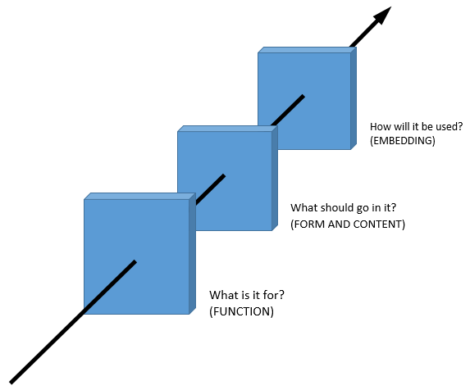
HOW SHOULD WE STRUCTURE THIS?
Landing page (purpose and structure; how to use)
A process segment, about producing and maintaining a code?
Database of examples (with searchable metadata)
Other resources (e.g. a special discussion of whistleblowing)
Feedback mechanism

Slide 16
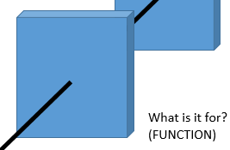
The FUNCTION stage…
Nature of the organization (charity, professional association, public body, limited company, regulatory body,…)
What need is it addressing? (Legal requirement, work culture, ethics of a professional sphere?)
Minimal threshold or aspirational? (Relates to embedding)
Inward or outward looking? (E.g. Publicising standards vs. practitioners clarifying their own standards)

Slide 17
REVIEW OF THE DAY
Suggestions for the toolkit
Thoughts about:
Bullying and harassment
Whistleblowing and confidentiality

Slide 18
THANK YOU FOR YOUR PARTICIPATION TODAY

